Slide 1

IT SERVICE HELP DESK

Slide 2
CONTENT:
What is Help Desk?
Who should use these?
Features of Help Desk
Hierarchy of Help Desk
Flow of Help Desk
Conclusion

Slide 3
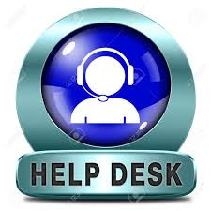
What’s Help desk?
Help desk applicatiom, provides first level support & assitance to the Project team for immediate troubleshooting. Application maitains a library of complaint/problems with there likely solutions that can be suggested to the Project team online.

Slide 4
Who should use Help Desk?
Companies that provide IT network Management Service
The organization who want to provide the instant solution to their project team.

Slide 5
Features of Help Desk
Web based application
Authenticated User Login
Categorized user/complaint management
Instant solution
Tracking complaints and maintain history each advanced search options
Solutions for complaints

Slide 6


Hierarchy of Help Desk
Project team
Agent
Person who attends calls/mails of customer and logs complaints on behalf of Project team searches solution tutorial and provide instant solution
The team has to seeking solution enters the problem or searches solution for particular problem

Slide 7
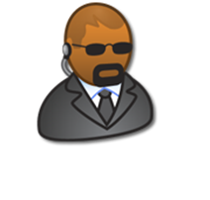

Analyst
Specialist
Specialized person with ultimate responsibility for providing solution to customer. He updates the tutorials and solutions
Person who categorizes the problem and assigns it to a specialist also updates complaint status

Slide 8
Flow of Help Desk
Provides solution
Problem solved/unsolved
Specialist
Project team
Distributes complaints send back
Phone/mail
Login complaint
Complaint through
Logs complain
For Project team
Analyst
Technician

Slide 9
Conclusion
The key for having a successful business is not just comingup with a product that amazes everybody, but actually providing those who buy it, a support level that ensures customer delight

